Slide 1
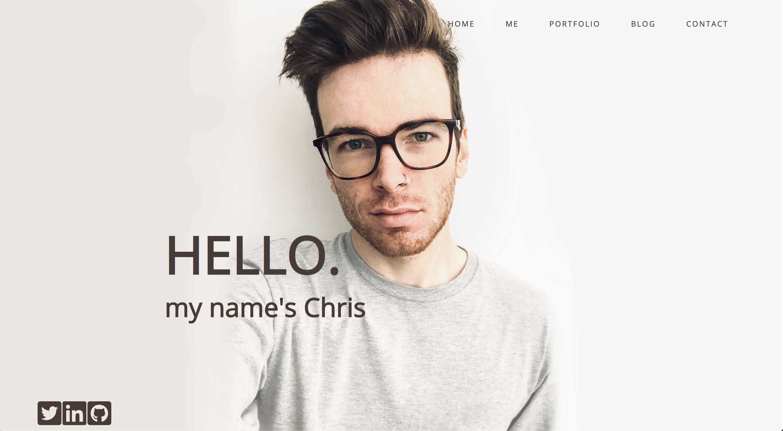
T1A3 Coder Academy
Christopher Dalziel

Slide 2
Design
Dribble
Created an inspiration plan
Draw a Wireframe plan
Have it not go to plan
Colour pallet
Font provided by: Google Fonts
Icons provided by: Font Awesome
Images provided by: Me

Slide 3
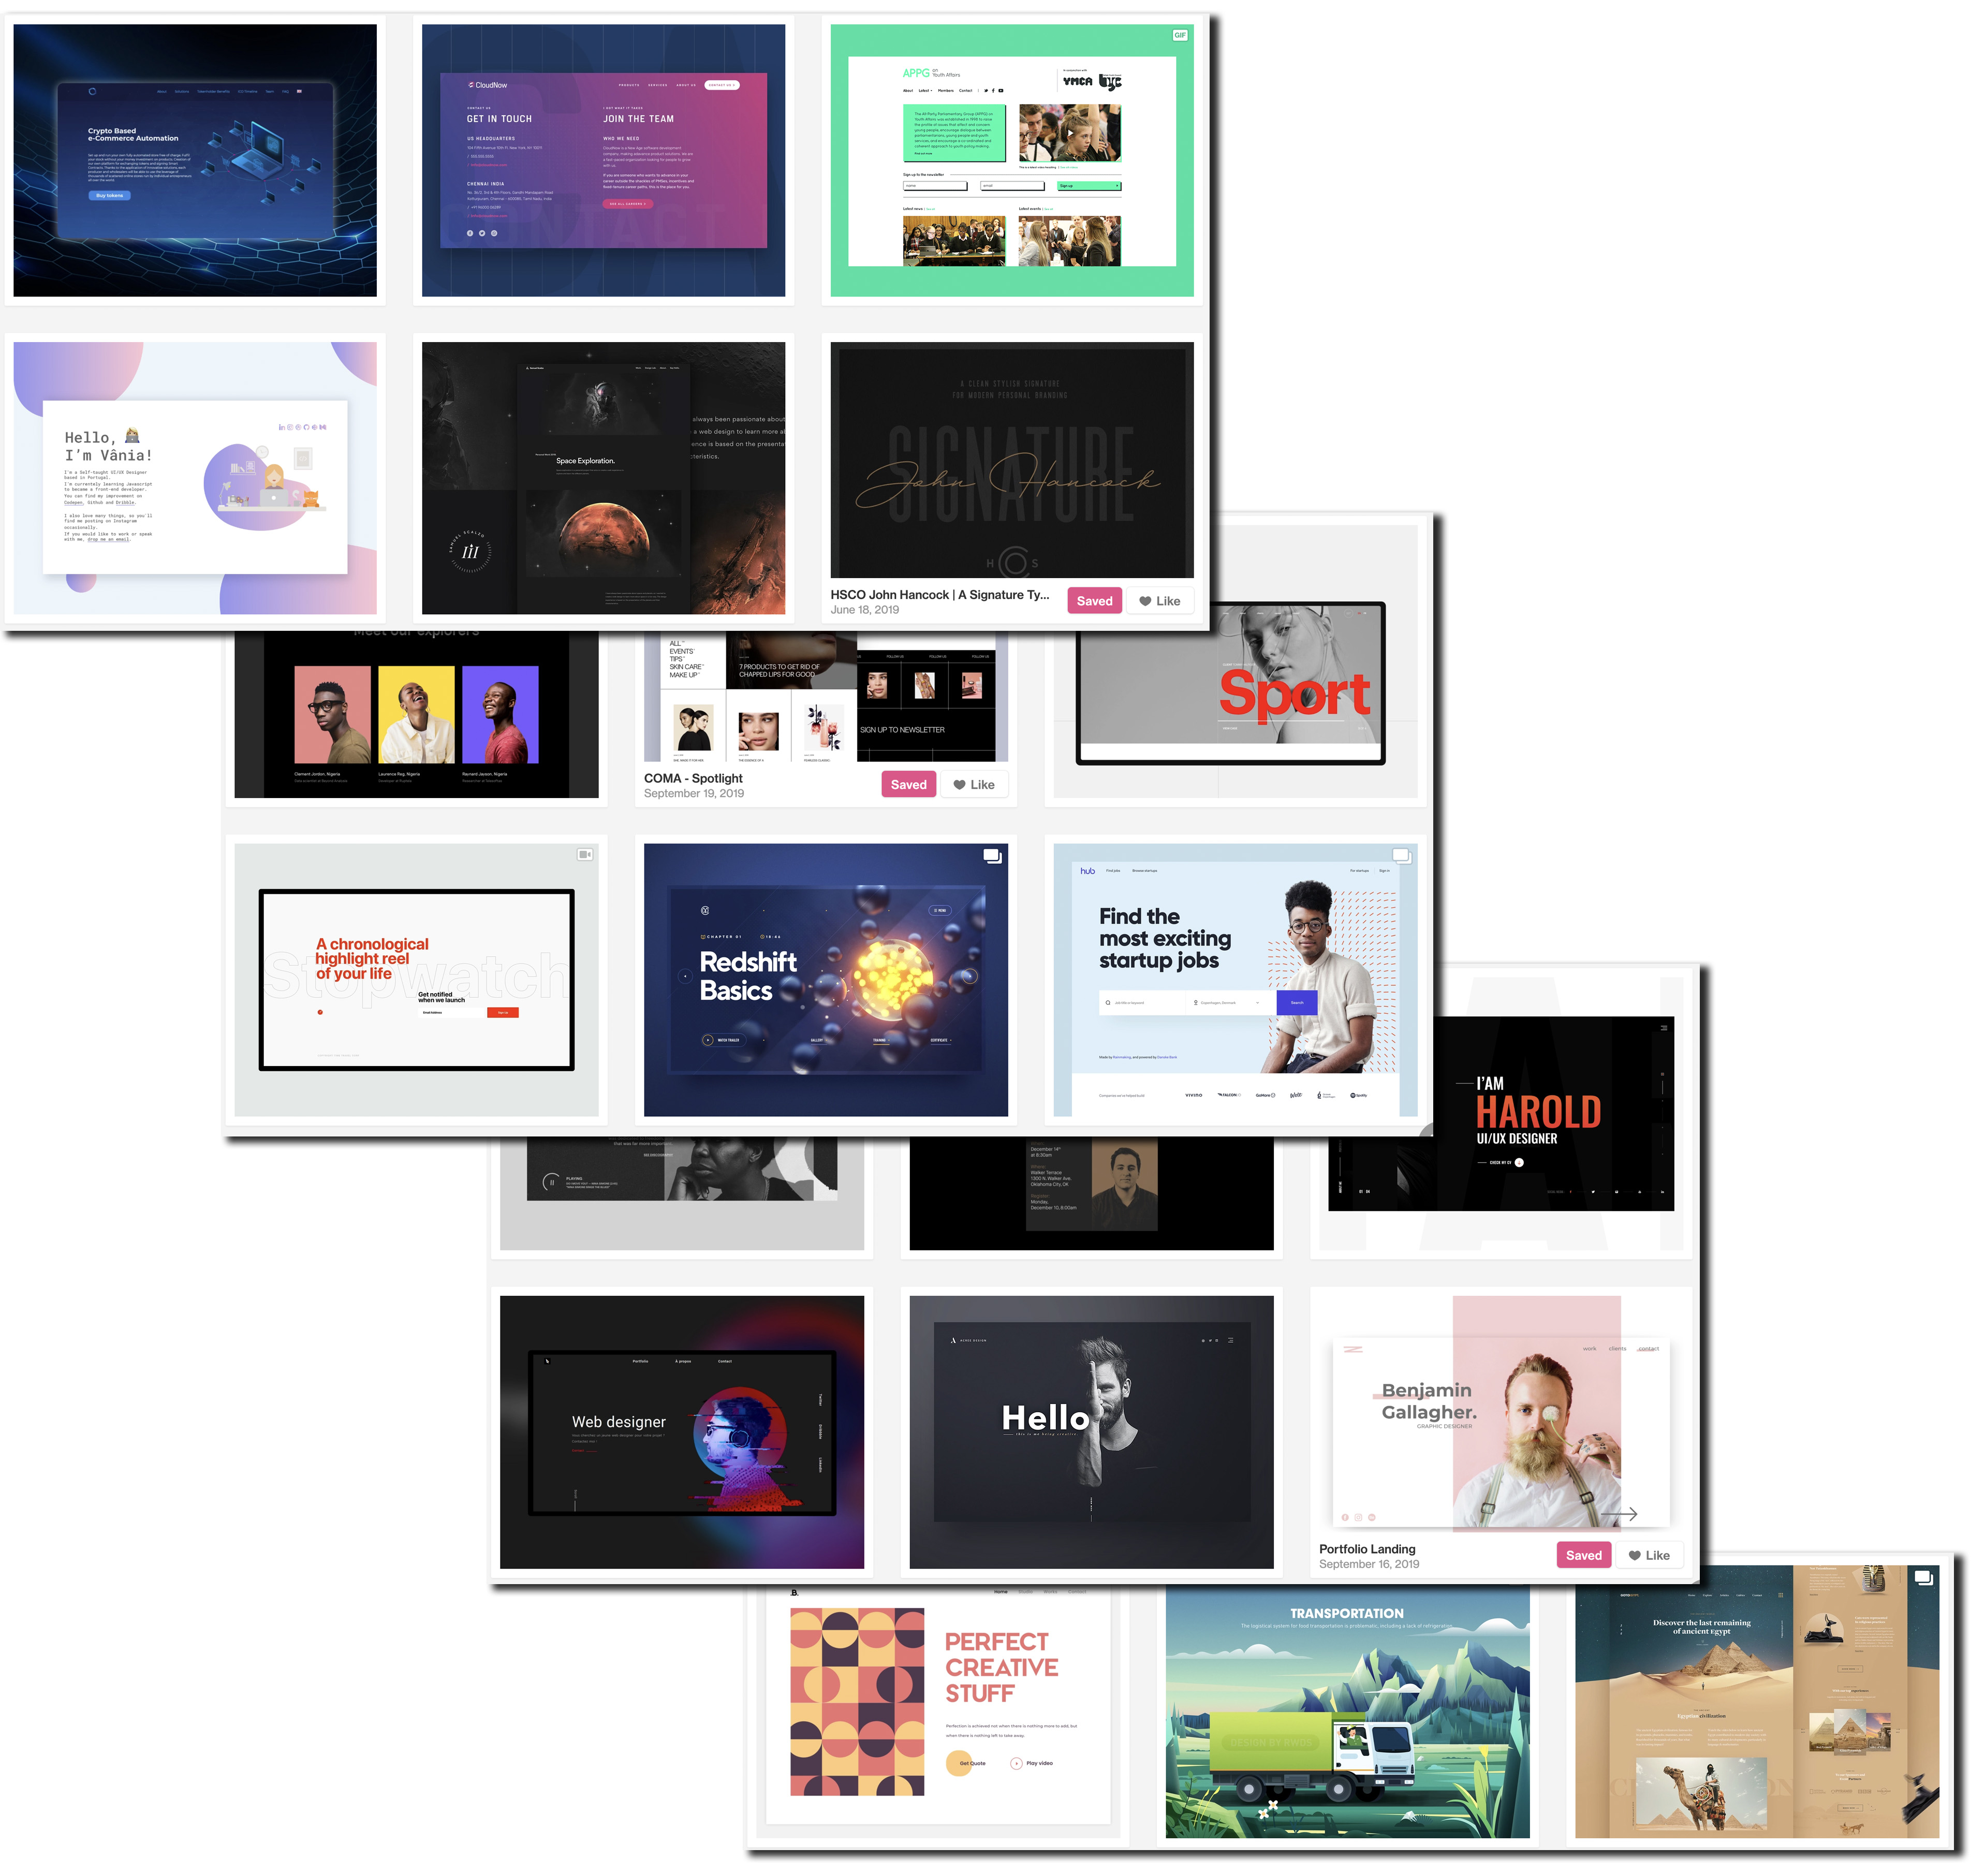
Design - Dribble

Slide 4

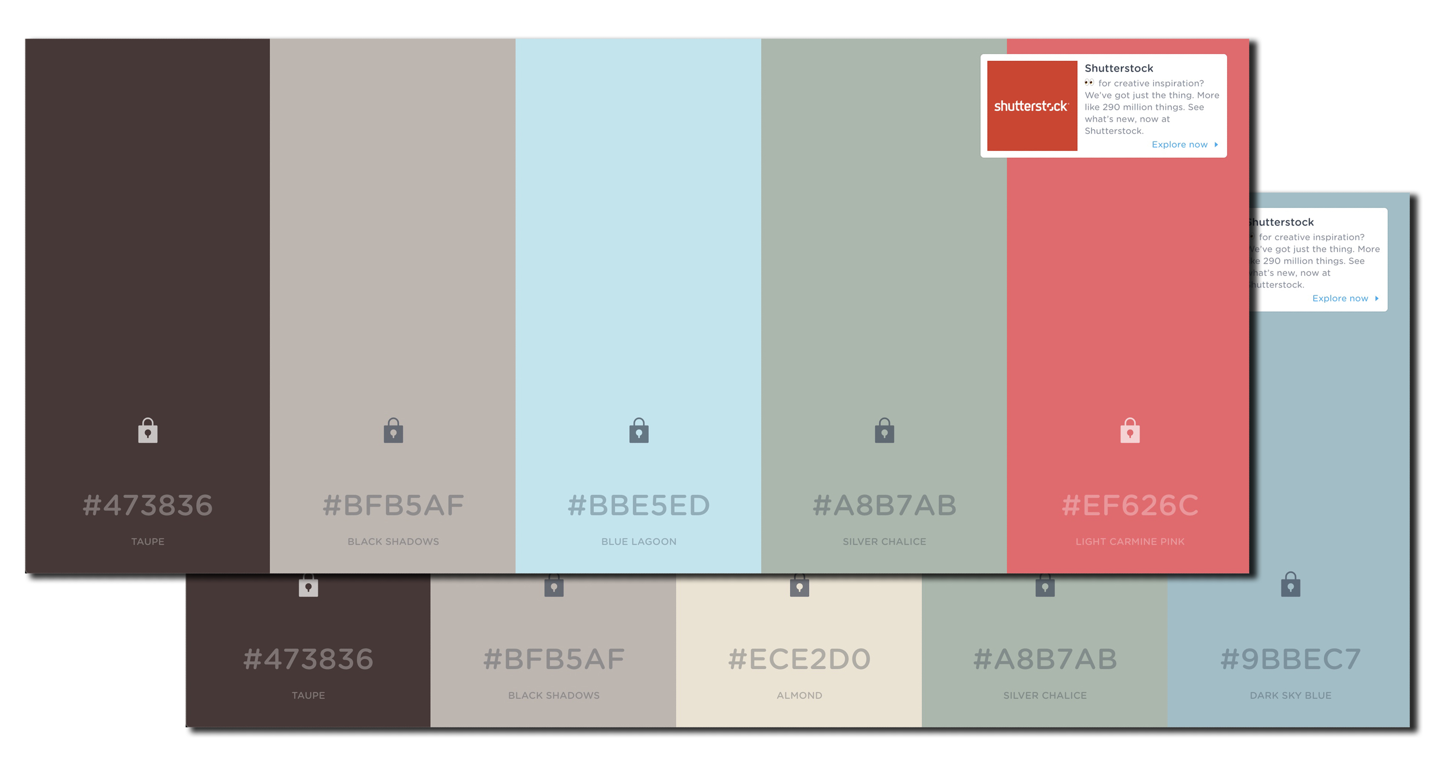
Colour Pallet

Slide 5
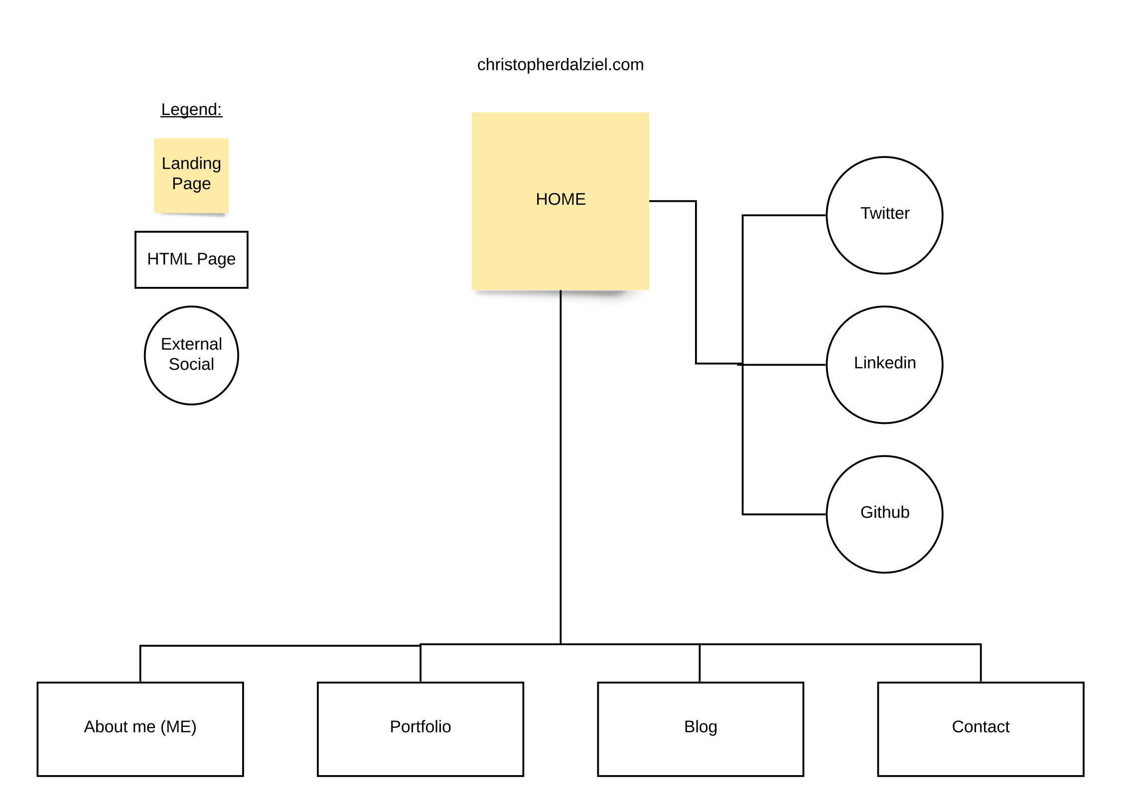
Sitemap

Slide 6
Components
Navigation bar
Mobile Navigation bar
Footer with professional social links
Google Fonts
Animated portfolio grid display
Overflow scroll on pages that would normally be over 100vh
Contact form

Slide 7
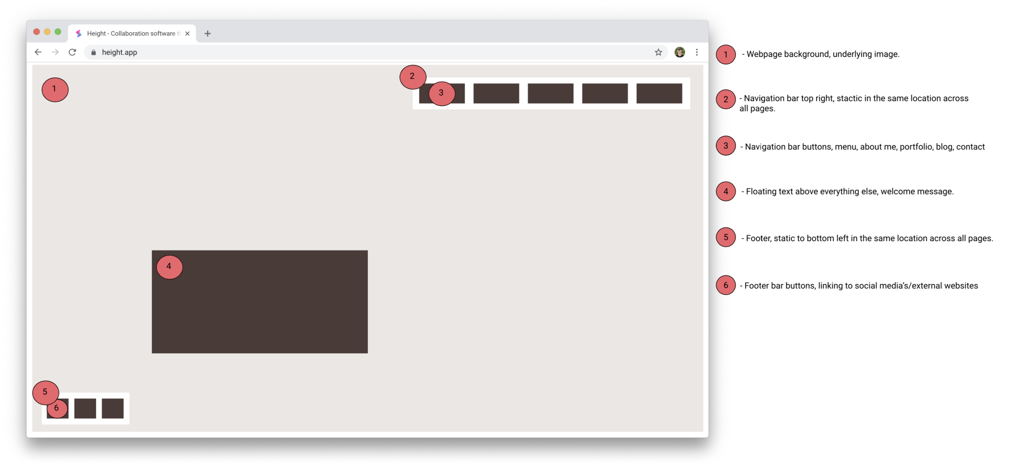
Home page
Hovering text/Hero image
Navigation Bar
Footer

Slide 8
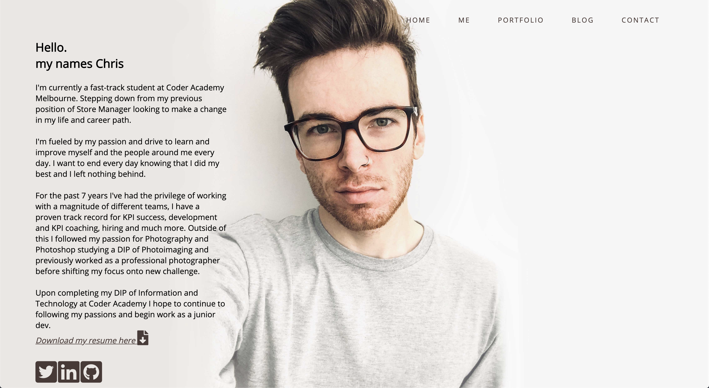
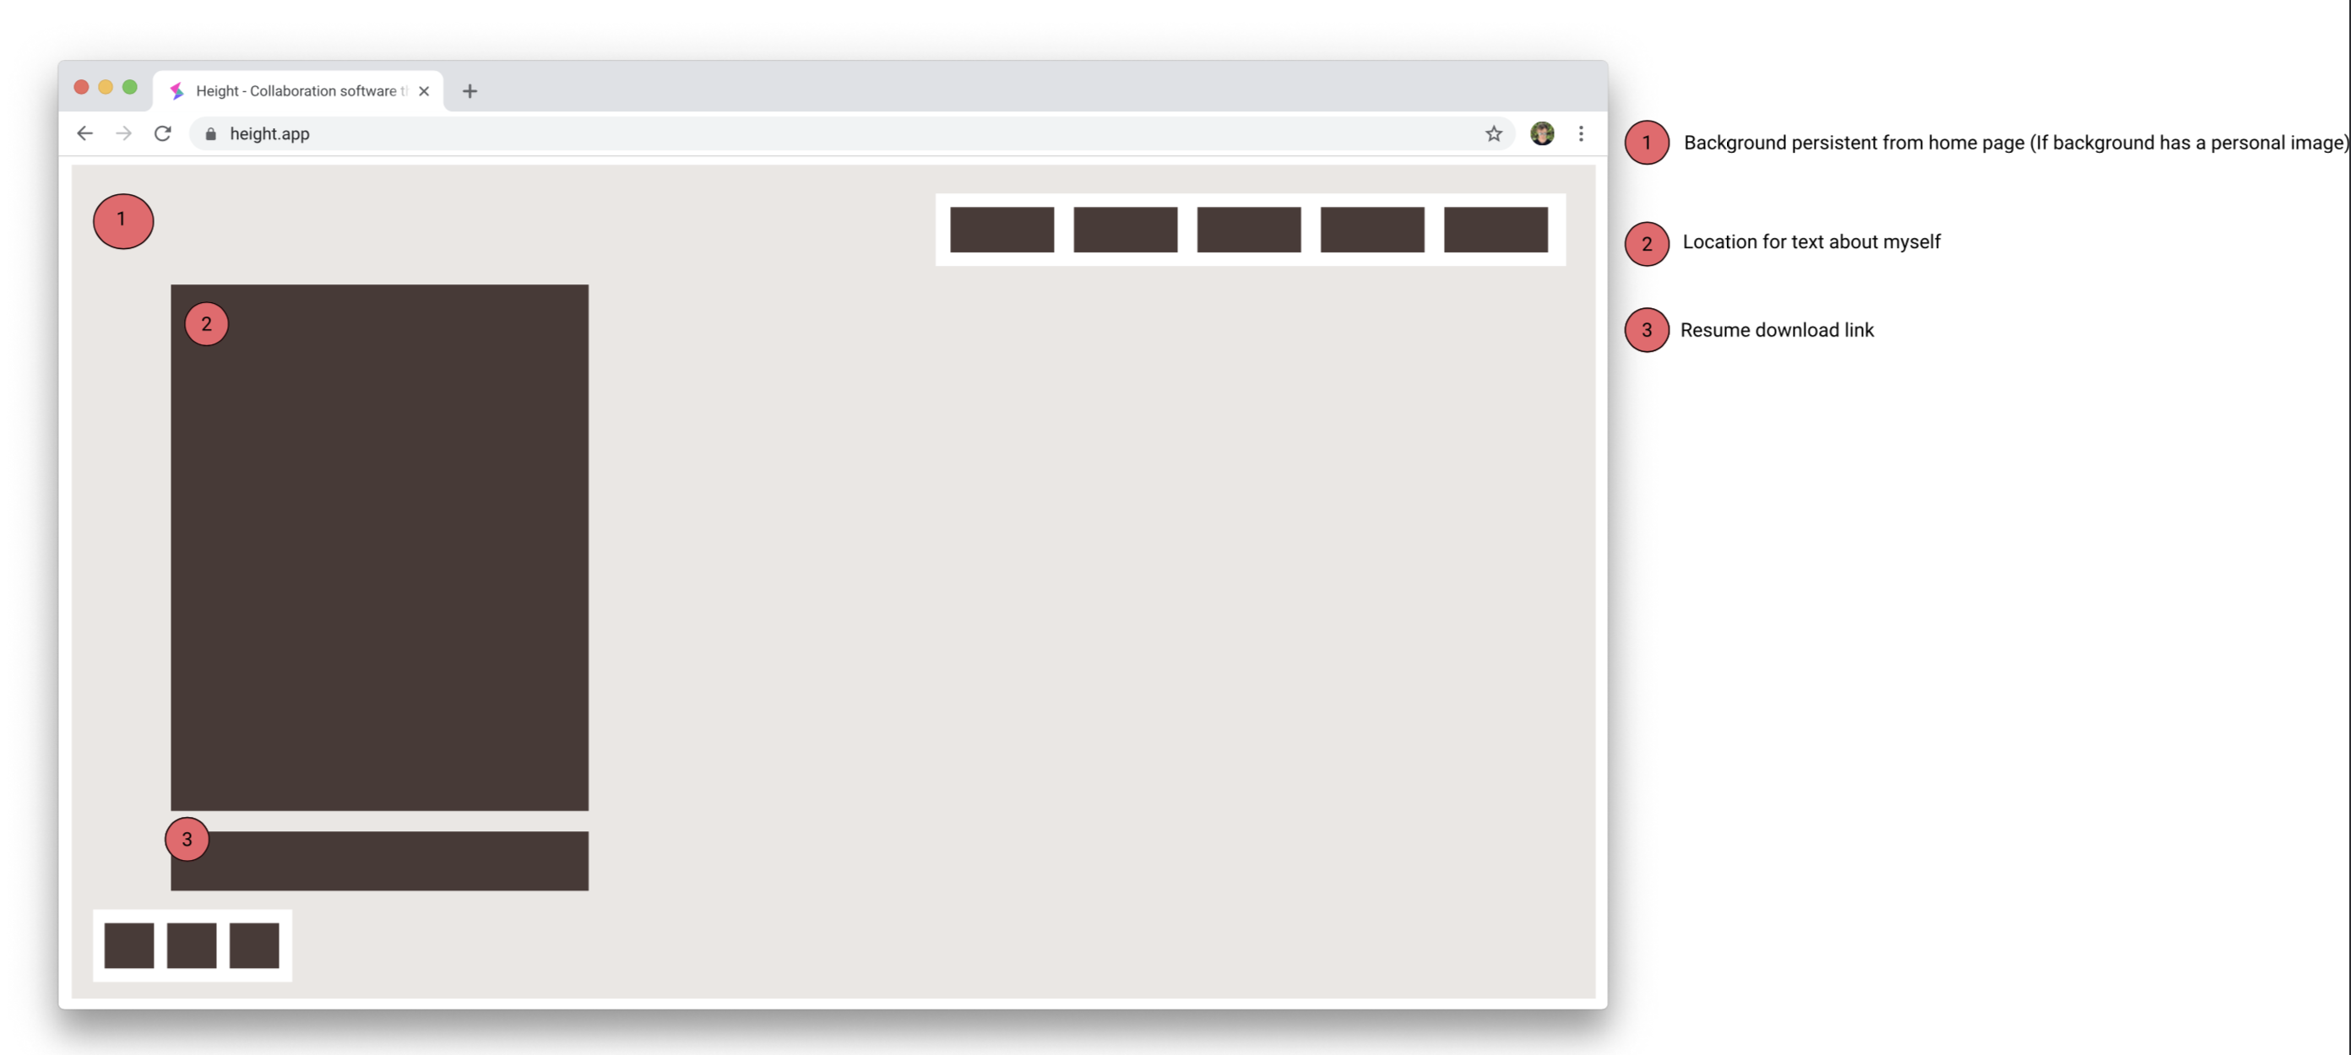
About Me
Background image continues as main focus
About me
Resume download

Slide 9
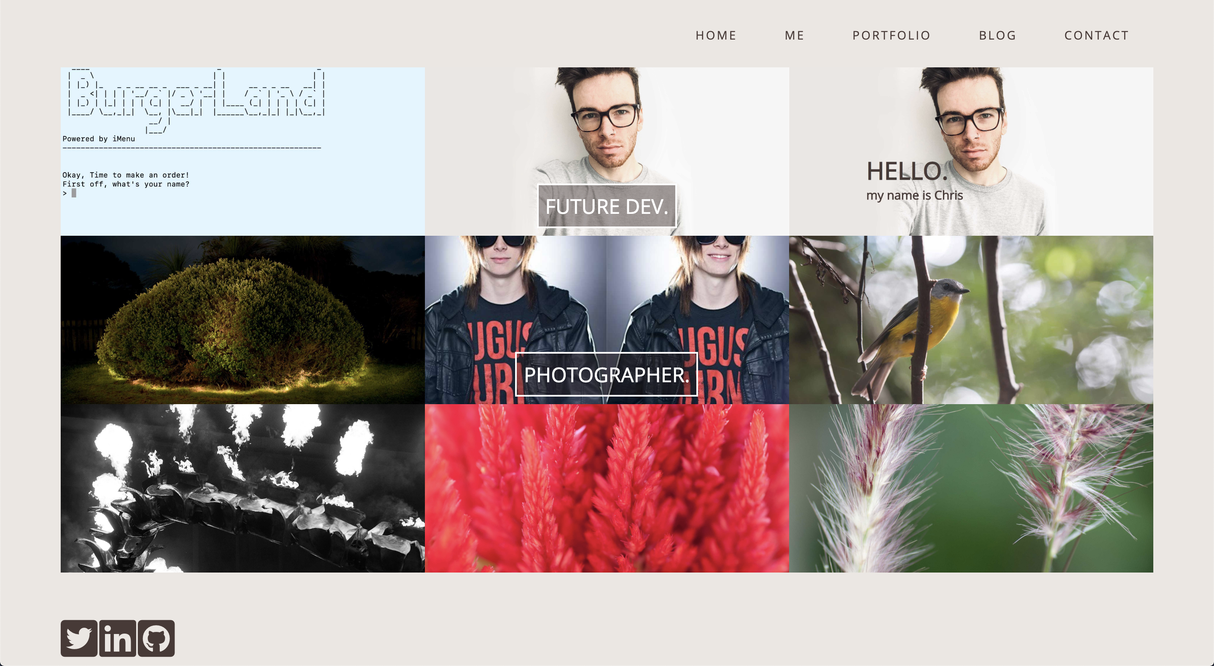
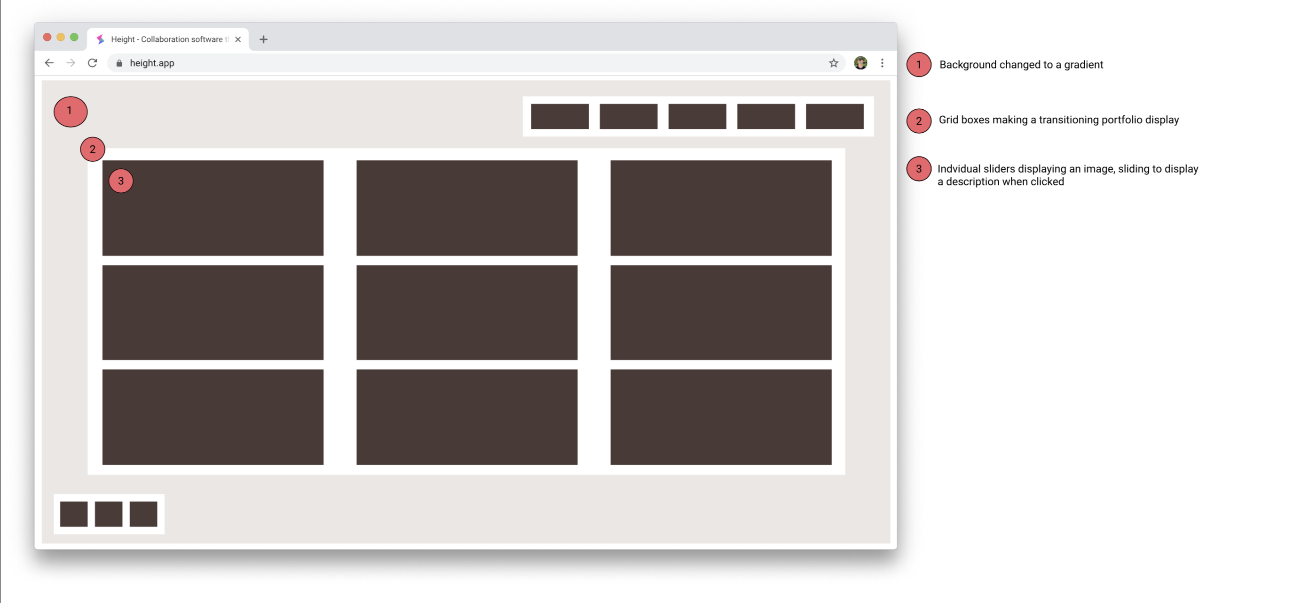
portfolio
Grids on grids on grids
Changeability and the future
How?

Slide 10
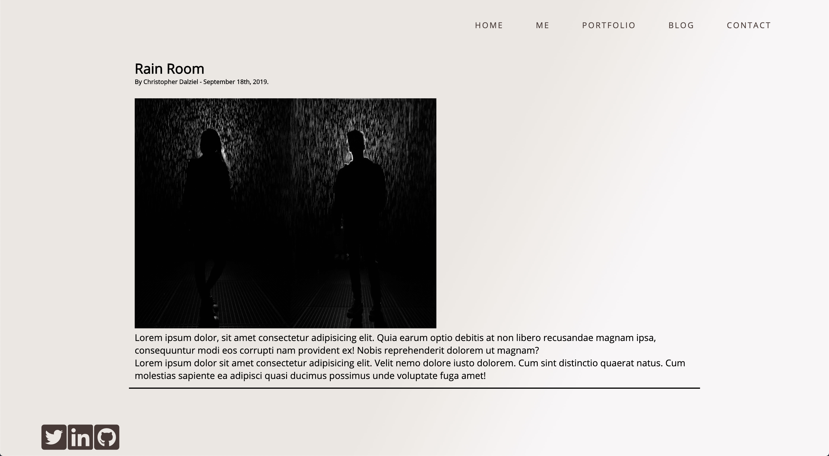
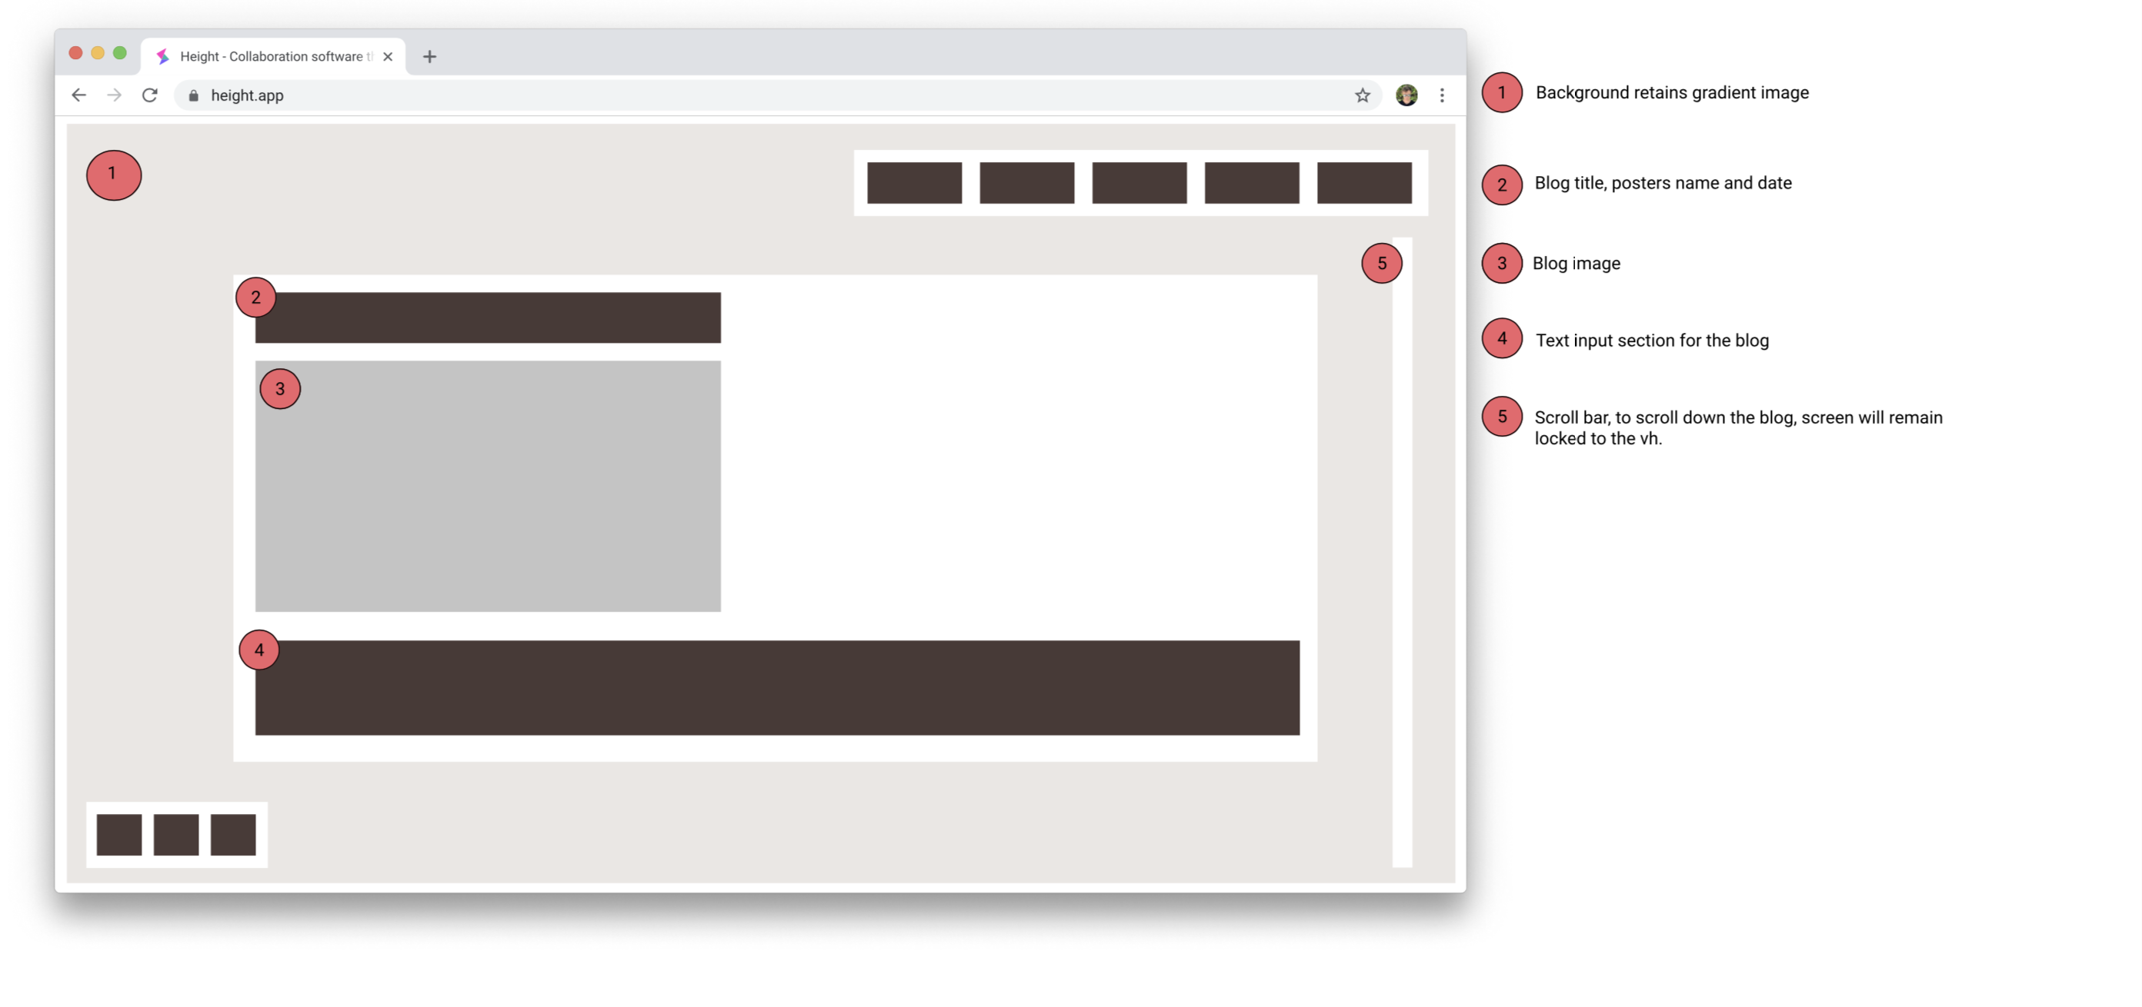
blog
Easy to read, continue my minimalistic theme
100vh overflow scroll - reasoning

Slide 11
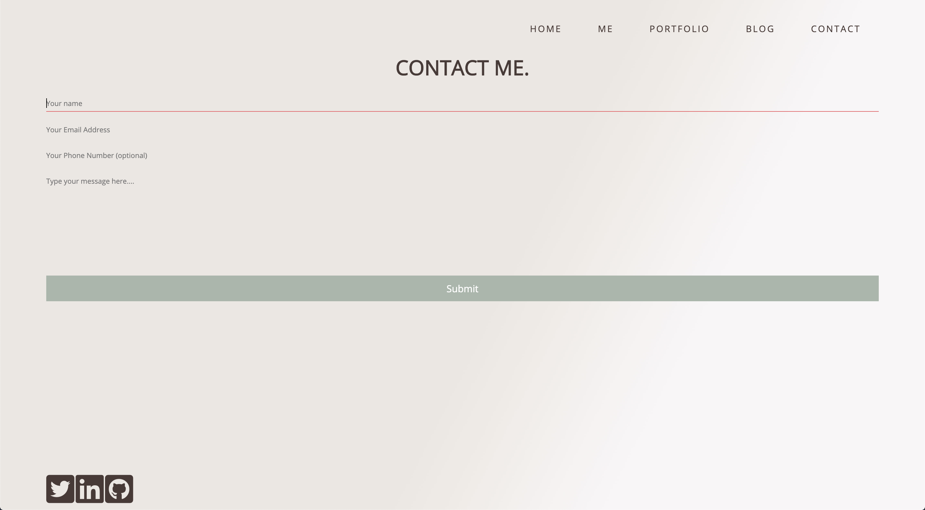
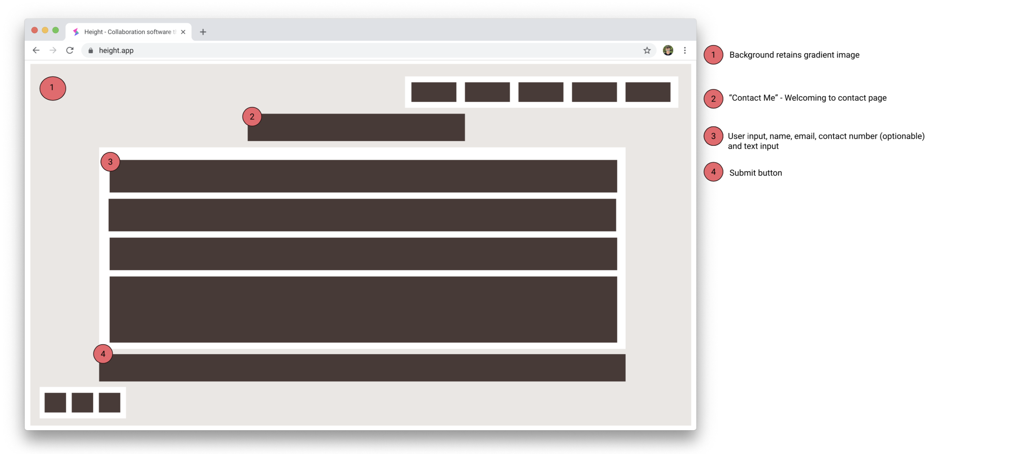
Contact me
Upon opening the page entering you into the first field
Optionable input
Borders for focus
Formspree

Slide 12

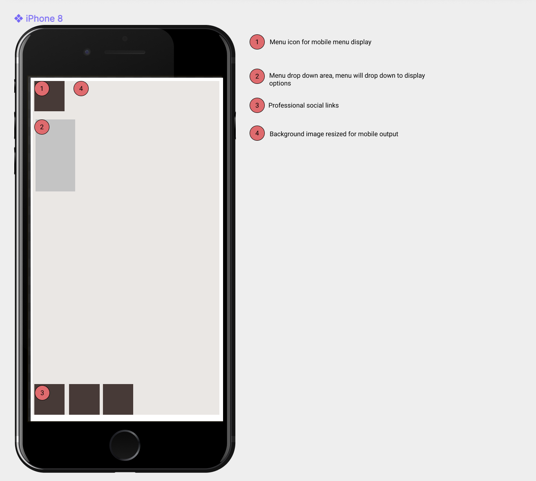
mobile
The challenge of mobile
Broken website - made me 110% perfect every page
Drop down menu

Slide 13
The grind
Knowing the design I was going for early on definitely helped me not get too caught up in the small things
I discovered I really did enjoy the front end design aspects of this and every time (sometimes when) you make an adjustment you get an instant result.
Locking yourself to 100vh can cause you headaches, any time something didn’t perfectly fit between those parameters my navbar, footer or something else would become pushed out.
The hovering text also broke my page at least 50 times, but sticking to my guns made the finished product a much sweeter achievement.
Responsiveness brings many problems but really makes you think about the design process in the future.

Slide 14
christopherdalziel.com

